Slide 1
Where You Lead, They Will Follow
CERP 2nd Annual Community Health Matters Forum
Presented by Karin Douglas, Senior Consultant,
Georgia Center for Nonprofits

Slide 2
Georgia Center for Nonprofits
build thriving communities by helping nonprofits succeed
Nonprofit University – courses & custom training
Nonprofit Consulting Group – strategy & capacity
Nonprofit Marketplace – buying consortium
Notes:
Share where we at GCN feel the “field” of leadership is focusing and moving primarily through the lens of our publication NOW

Slide 3
3 Vantage Points
Boardroom
Corner Office
Community
Notes:
Board – Strategy Corner Office – Program Implementation Community - Support

Slide 4
Board Leadership: Why do they serve?
1. To serve the organization and contribute to its success 2. To be helpful to others 3. To contribute to society 4. Sense of duty/commitment to the mission 5. To help the particular group that this organization serves 6. To share my expertise and professional skills 7. Out of loyalty to and respect for the organization 8. A desire to work with others 9. To learn more about the organization & the cause it supports 10. Opportunity for personal growth
Source: Board Member Motivation at Georgia Non­profits, GCN/Old Dominion University/Seattle University / NOW Winter 2014
Notes:
Motivation Survey of 726 Nonprofits in GA – If we know why we’re there, we will have a clue as to what we should do with them

Slide 5
WHY is the Board on Board?
Why was each member recruited/”voluntold”
What will they do this year?
Notes:
However they came together, the bottom line is that they are your asset to manage – even though they may/should govern themselves

Slide 6
6 Steps to a Leadership Plan
Discuss interests & strengths
Looking at where interests and strengths align, develop a set of goals for the year. These goals should all follow the SMART rubric: Specific, Measurable, Achievable, Realistic, Time-bound
Create at least one action step for every goal – practical and specific
Decide on a timetable for achieving each goal
Determine an evaluation method for each goal – how you will measure what has been accomplished
Discuss the kinds of support your board member will need to fulfill their goals, including technical considerations and personnel to involve
Source: Moving in the Spirit/NOW Winter 2014
Notes:
Moving in the Spirit (NOW Winter 2014) 18 MONTH vetting process

Slide 7
“Clear strategic planning is essential for a nonprofit’s success [and] shows thought leadership on the part of the staff and board, while also providing an entry point for a funder to identify where their goals and priorities align”-
Karen Paty of Georgia Council for the Arts
GCN findings:
nearly half of all strategic plans don’t include revenue planning
Many suffer from “low market focus” – no consideration of data from outside the organization (competitive landscape, larger economy, voices of the community)
Notes:
Strong strategic plans are important to foundations because they want to make a great impact!

Slide 8
Strategic planning…and thinking:
Notes:
Strategy isn’t something that’s thought about once every 4 years when it’s time to develop a strategic plan – it’s a way of thinking. Therefore, there’s no harm in doing a SWOT analysis of programs, processes, collaborations, at ANY time.

Slide 9
What are the 2 Most Important things you must accomplish this year in the area of external relations to begin building sustainability for your organization/program/initiative?

Slide 10
Organizational Leadership
…really isn’t about authority or position
Notes:
Look at what happens within the four walls of your office…among the people that get paid

Slide 11
The 5 Levels of Leadership
by John C. Maxwell

Slide 12
Leadership Development
What is your senior leadership team going to look like in 3 years?
Do you have the internal talent you need to execute strategic priorities over the next three years? For which positions are you likely to need to look externally?
What are you doing to develop internal talent?
Who are the rising stars your board should meet?
What are you doing to develop yourself?
What can the board do to help you with your development or the development of your staff?

Slide 13
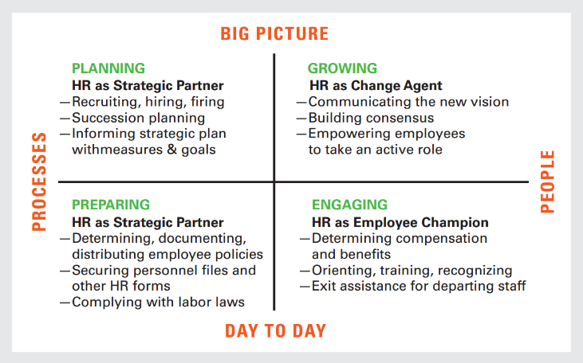
Seriously Consider HR

Slide 14
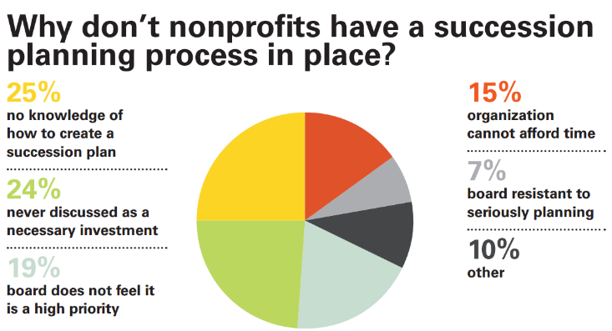
73% of Atlanta nonprofits do not have written succession plans
69% do not have an emergency succession plan in place
Notes:
ASK for a show of hands

Slide 15
Leadership in the Commmunity
Thought leadership
Partnerships, collaborations & collective impact
Advocacy
Volunteer engagement
Fundraising

Slide 16
Thought Leadership
“…becoming an authority on relevant topics by delivering the answers to the biggest questions on the minds of your target audience”
“…thought leadership should intrigue, challenge, and inspire…”
Source: forbes.com 1/30/2013

Slide 17
5 Steps To Create Thought Leadership That Drives Results
Identify the questions your customers are asking. Identify them all. Then prioritize them.
Answer those questions across multiple formats and multiple channels in a way that adds value to your audience. Start with the most important and work your way down the list. All you have to do is have the right content to answer the basic questions.
You gotta “Give to Get” so do not promote or put registration hurdles in front of your thought leadership content.
Make it interesting…Timo Elliott calls this the “Return on Interesting” that you get when your content rises above the noise of all the boring, overly-promotional, gated content that is bombarding your audience. Educate them? Yes. But try to entertain them in the process. Tell stories. Use examples.
Invite customers to participate: I love the idea of interviewing customers to create content or curating content from other sources while adding your own perspective.
Source: Michael Brenner/Forbes.com 1/30/2013

Slide 19
Partnerships
“Networks of Responsibility”
People Networks
Business Allies
Government Partners
Diana Aviv, Independent Sector/NOW Winter 2015

Slide 20
Volunteer Engagement
IN GEORGIA
24.8% of residents volunteer, ranking them 37th among the 50 states and Washington,DC.
1.79 million volunteers
180.0 million hours of service
$4.1 billion of service contributed
30.3 volunteer hours per capita
Source: Corporation for National and Community Service 2013

Slide 21
Millennials
Born 1980-2000
“If government or nonprofits aren’t moving fast or being effective, Millennials will channel their efforts through corporations or communities. And if corporations and communities aren’t working they’ll use their dollars, followers, and friends to demand change or to support those institutions that are making change happen on their terms.”
Jean Case of the Case Foundation from “Cause for Change”

Slide 22
Connecting with Volunteers
Seek their input
Create a mutually validating climate
Communicate their contributions
Address them by name
Invite them in
Keep them informed
Encourage their creativity
Set high standards
Source: Rick Lynch/NOW Winter 2013

Slide 23
Georgia Gives Day info
http://www.gcn.org/blog/Georgia-Gives-Day/Georgia-Gives-Day-2014-By-the-Numbers

Slide 24
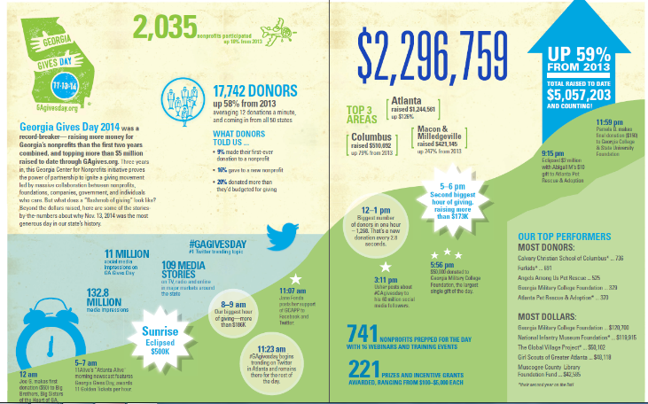

Slide 25
Fundraising: Before the “Big Ask”
Assuming they’re interested, even enthused, they’re still not going to toss their money into a black hole
Are you doing important work?
Are you well managed?
Will my gift make a difference?
Will the experience be satisfying to me?
Source: Howard Stevenson & Shirley Spence/NOW Winter 2014
Notes:
In order to secure supporters and advocates you’ve got to answer 1 & 2; to secure a gift you have to answer 3 & 4

Slide 26
Q & A
Additional resources
greatleadersserve.com
casefoundation.org
themillennialimpact.com
Contact: Nicole Morado – nmorado@gcn.org – for more information about the consulting practice at Georgia Center for Nonprofits

